Slide 1

Quality & Network

Slide 2
Network
Quality
Top tier Conference/Journal
Co-operate with famous researcher
High Citation
Mentor decide your level
Research Productivity

Slide 3


Quality Evaluation Algorithm
Academic knowledge API
Analysis
Citation Number
Citation per Paper
Date of Conference/Journal
Probability of Top Conference/Journal
Conference name
Number of Publication
Information of Authors

Slide 4
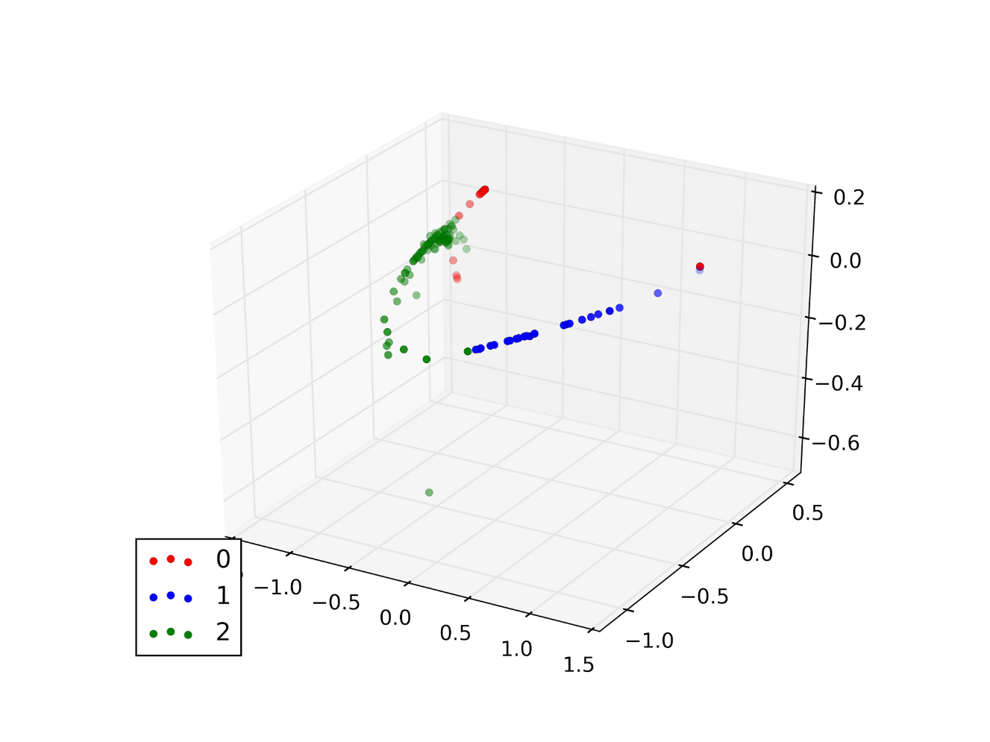
Quality Score
Citation Number
Normalization → Standard score
Date of Conference/Journal
Kmeans for unsupervised clustering
Conference name
Isomaric Maping for dimension reduction
Information of Authors

Slide 5
Network Reputation Algorithm
Academic knowledge API
Analysis
Prior: the average reputation of the subnetwork
Co-author Information
Posterior: the true reputation of the author
Citation Number
Surprise quantify the KL Divergence of prior and posterior

Slide 6
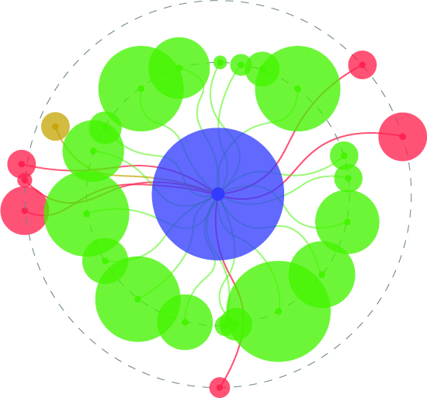
Data Visualization
中间圆形的大小代表这个人的学术影响（论文平均引用数）
中间圆形的颜色代表代表学术年龄，年纪越大颜色越深, 越年轻颜色越浅
外围每个圆圈代表发布的一篇学术论文
外围每个圆圈的大小代表该学术论文的引用数
每个圆圈的颜色和位置代表所发布的论文的会议等级
内圈绿色代表最高水准会议和平台
越向外发布平台权威性越低

Slide 7
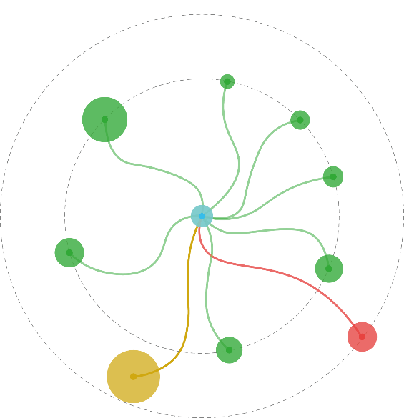
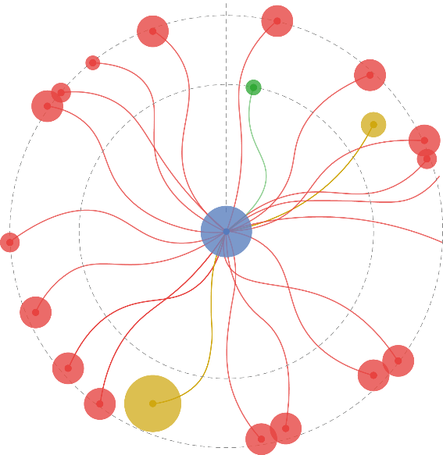
Data Visualization
典型大牛图样
学术新星
一般学者

Slide 8
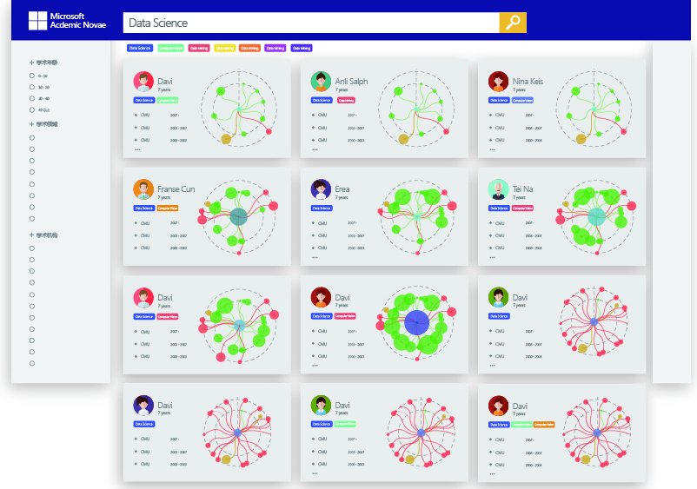
User Interface

Slide 9
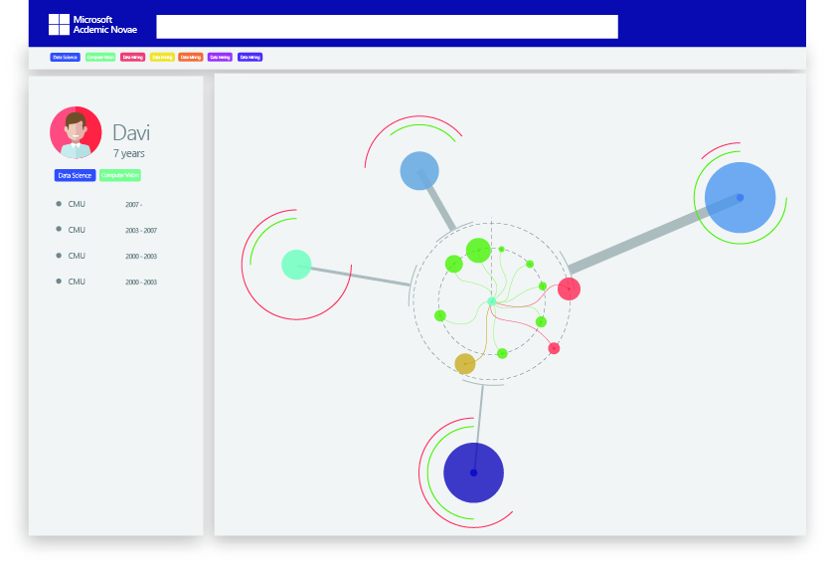
User Interface

Slide 10
In Future
Help Students: Ideal Mentors Matching
College-Enterprise cooperation: find ambitious young professors

Slide 11
